Slide 1
Presentation on
Blood Transfusion and Thalassemia
Dr Jannatul Ferdous
Associate professor
Department of Transfusion Medicine
Mugda Medical College,Dhaka
11 th Nov,2018

Slide 2
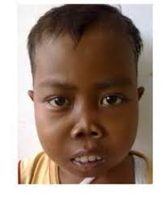
Thalassemia in 1960s

Slide 3
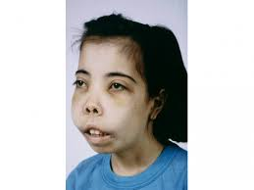
Thalassemia in 1960s

Slide 4
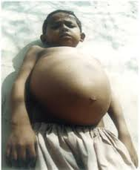
Thalassemia in 1960s

Slide 5
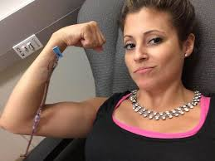
Thalassemia Now

Slide 6
Management
Options for treatment
Blood Transfusion
Iron Chelation
Observation and supportive care (Folic acid)
Fetal Hb inducing agent (Hydroxyurea)
Splenectomy
Management of complication
Allogenic Bone marrow transplantation

Slide 7
Aim of regular Blood Transfusion
To c0rrect Anaemia
To suppress the abnormal erythroid hyperplasia(ineffective erythropoiesis)
To prevent most of the serious complications of Thalassaemia.
However, once started, the Transfusion –related complications become a major source of morbidity.

Slide 8
Benefits of Blood transfusion
Benefits of Anaemia correction
Improves the O2 delivery to the tissue
Facilitate normal growth and development of Thalassaemia child
Improve the quality of life near to normal

Slide 9
Benefits of Blood transfusion
Benefits of suppression of Erythroid Hyperplasia
Stops the bone expansion and distortion
Limits excessive Iron absorption
Reduces the extra medullary hemopoiesis.

Slide 10
Guidelines for transfusion
Whom to Transfuse?
When to start transfusion?
What blood product to be transfused?
How to give transfusion?
How to optimize transfusion?

Slide 11
Whom to transfuse?
Transfusion Dependent Thalassemia (TDT) Severe Beta Thalassemia (Beta Thalassemia Major) Severe Hb E Beta Thalassemia | Regular transfusion
Non Transfusion Dependent Thalassemia (NTDT) Less severe Beta Thalassemia (Beta Thalassemia Intermedia) Less severe Hb E Beta Thalassemia | Intermittent or occasional transfusion
Traits Beta Thalassemia / Hemoglobin E (if anemic, search for a plausible cause) | No transfusion

Slide 12
Whom to Transfuse?
Non Transfusion Dependent Thalassemia (NTDT)
25% need regular transfusion
50% need intermittent /on demand transfusion
25% need only occasional transfusion
The newly diagnosed patient with thalassemia should not be transfused immediately upon diagnosis.
Rather, the treating physician must determine the clinical severity and make a decision of transfusion to achieve optimal growth and quality of life.
Often a period of observation is required to determine baseline hemoglobin and clinical severity.

Slide 13
When to start transfusion?
TDT
Confirmed diagnosis of TDT
Laboratory criteria:
Hb< 6- 7gm /dl on 2 occasions 2 weeks apart(excluding all other contributing causes e.g- infection, pregnancy, stress)

Slide 14
When to start transfusion?
NTDT
Clinical criteria irrespective of Hb level
Hb > 7gm/dl with any of the following condition
Facial Changes
Poor growth
Fractures
Clinically significant extramedullary hematopoiesis

Slide 15
When to start transfusion?
Important note
Differentiation between TDT and NTDT is essential
Careful analysis of clinical, hematological, genetic and
molecular analysis may allow reasonable conclusion of treatment.

Slide 16
When to start transfusion?
NTDT – other considerations
Transfusion is individualized
Hb level should not be an indicator except with severe anemia(< 6gm/dl)
Transfusions are unlikely to be necessary if the patient maintains
a reasonable appetite,
level of energy,
quality of life,
growth velocity,
sexual maturation in parallel with bone age, and
if the spleen size is stable, enlarging at a rate < than 3 cm/year.

Slide 17
When to transfuse?
Stress/Special situation
Occasional transfusion is needed in stress
Infection
Surgery
Pregnancy
In management or prophylaxis of the following complication
Pulmonary hypertension
Extramedullary pseudotumor (spinal cord compression, paraplegia, intrathoracic masses)
Leg ulcer

Slide 18
What blood product to be transfused?
Source of Blood
Blood Donor:
Voluntary, regular, and non-remunerated
Directed donation and relatives are strictly prohibited
Avoid first degree relatives as much as possible
Careful Donor Selection: by a physician
Follow the MAD(medical aspect of Donor
Through questionnaires
Written informed consent of Donor
Donor counseling about donation procedure and post donation care.

Slide 19
What blood product to be transfused?
Blood Collection:
With all aseptic precaution
From suitable veins
Collection completed within 8 minutes.
Blood should be collected, processed, stored and distributed by dedicated quality assured blood transfusion center.

Slide 20
What blood product to be transfused?
Transfusion Serology(Lab work)
Compatibility testing
Screening of Donors Blood
Pre donation(usually practiced)
Post donation(preferred)

Slide 21
What blood product to be transfused? Compatibility testing
Comprises 3 tests
1. Blood grouping of both patient and donor
Both forward and reverse typing
Extended Blood grouping(ABO,Rh (D,C,c,E,and e),Kell, Kid. Duffy), at least ABO,Rh and Kell.
Daily practice: only ABO and RhD forward groping.
2. Antibody screening of patients serum by ICT method.
Routinely not done.
3. Cross matching (Major, minor and auto control) by ICT method(2 hours procedure)
Daily practice: Saline cross match at room temp.

Slide 22
What blood product to be transfused? TTI Screening
WHO recommended Tests
Hbs Ag
Anti HCV
Anti HIV
Malarial parasite and
VDRL

Slide 23
What blood product to be transfused? TTI Screening
Method of testing
ICT ( sensitivity varies, low cost, less time, majority center)
ELISA( recommended, few center, expensive and 2 to 3 hours procedure )
NAT( not available and very expensive)

Slide 24
What blood product to be transfused? Recommended Blood product
Red cell concentrate/Packed red cells(PCV 60 -70%)
Leuco reduced /Leuco depleted Red cell
RCC storage period: <2 weeks is preferred.

Slide 25
Leucoruduced Red cells, Why?
Adverse effect of leucocytes in blood product
Reactions | Causative Agents
Non Haemolytic Febrile Transfusion reaction | HLA antibodies in patient, cytokine reactions produced by donor leucocytes
Alloimmunisation of recipients | HLA alloimmunisation.
TTI (Transfusion Transmitted Infections | Cell associated infections such as CMV,EBV
TA-GVHD | Immunocompetent Donor s T lymphocytes.
TRALI | Pre formed Leuco-agglutinin in Donors plasma.

Slide 26
How to give transfusion?
Goals of Blood Transfusion Therapy
Use of donor erythrocyte with an optimal recovery and half life in the recipient.
Achievement of appropriate Hb level in recipient.
Avoidance of adverse reaction as much as possible including transmission of infectious agents.

Slide 27
How to give transfusion?
The goal of transfusion is to shut off ineffective erythropoiesis
The amount of blood is determined by pre-transfusion hemoglobin levels.
The target is to maintain the pre-transfusion hemoglobin level between 9 and 10 g/dL for TDT patients.

Slide 28
How to give transfusion?
For NTDT patients, baseline hemoglobin should be first established.
Pretransfusion hemoglobin level for NTDT should be individualized to alleviate symptoms and optimize growth and development. It should not based on a hemoglobin target.
Transfusions interval usually three to four weeks.
Transfusions should be maintained at a fixed schedule.
Post-transfusion hemoglobin should not exceed 14 g/dL.

Slide 29
How to give transfusion?
Transfusions given in an outpatient setting
Blood should be transfused at 15 mL-20ml/kg over 3-4hours,
Patients with severe anemia (hemoglobin less than 5 g/dL) or cardiac compromise, slower rate of transfusion (2 mL/kg per hour )
If cardiac insufficiency higher pre-transfusion hemoglobin levels (10 to 12 g/dL) should be maintained with smaller volume transfusions given every one to two weeks.

Slide 30
How to give transfusion?
The patient’s weight and pre-transfusion hemoglobin and the volume of transfusion should be recorded at each visit.
Periodic assessment of the volume of blood required to maintain the desired pre-transfusion hemoglobin level.

Slide 31
How to give transfusion?
Annual blood transfusion is valuable to identify changes
Hypersplenism or
Accelarated destruction of donor red cells
Annual blood transfusion requirement in patients without hypersplenism is usually below 200 mL packed red blood cells/kg per year.

Slide 32
BT Chart of a 30 Kg beta major boy
Month/ Date | Pre transfusuion Hb-gm/dl | Amount and type of blood | Post transfusion Hb-gm/dl
January/5/1/17 6/1/17 and 7/1/17 | 5.0 | 3 unit packed red cells-750 ml(Hct-60%) | 14
February 2/2/17 | 8.5 | 2 unit packed red cells-450 ml(Hct-60%) | 13.5

Slide 33
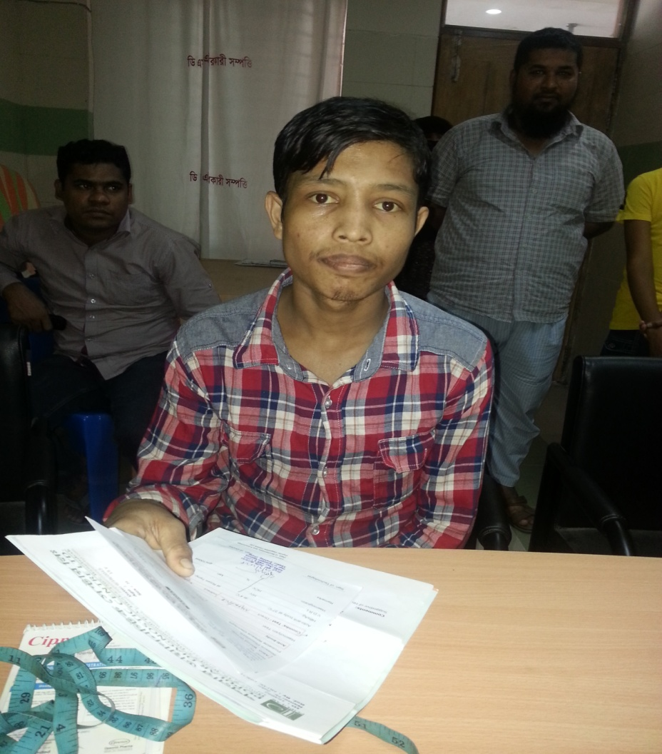
How to give transfusion? Intermedia pt needs intermittent transfusion

Slide 34
Problem associated with repeated Red cell transfusion
ACUTE | Cause | DELAYED | Cause
NHFTR | Cytokoine and Leucocyte alloimmunisation | 1. . Iron overload | repeated blood BT,250 mg iron/unit
2. Allergic and Anaphylactic | Plasma proteins. IgA deficiency. | Allo immue | Allo-antigen other than ABO and D
3. Fluid overload | Too much fluid, rapid Tx, renal | TTI( HBV,HCV and Others) | Lack of Screening. Improper Donor selection.
HTR | ABO incompatibility | Delayed HTR (5 to 10 days) | Allo- antibody
5. TRALI | Preformed anti neutrophil and HLA antibody. | 5. TA-Graft vs Host Disease | Immuno-competent Donors T cells

Slide 35
Prevention and Tx of Acute TR
Name | Prevention | Management
NHFTR | Leuco-reduced red cells | Slow the rate,Antipyretics.
Allergic | Washed red cells | Slow ,Anti histamine and Corticosteroid.
Anaphylactic(within minutes) | washed red cells,Blood from IgA deficient Donor. | Stop Trans.Steroid, Adrenalin and ICU support.
HTR( within minutes, 5-10 ml Blood) | Cross /D0uble Check and stictly follow the SOP. | Stop,O2,IV fluid,steroid,adrenaline,Dialysis.
TRALI | Avoid donation from multiparous woman/multitransfused pt | O2,steroid,Diuretics and ICU support

Slide 36
Prevention and Tx of Delayed complication
Name | Prevention | Tx
Delayed HTR | red cell Ab sreening of patient before each trnasfusion. | No Tx, if Hypotention and renal failure ,treat as Acute HTR
TTIs | Careful Donor selection Screening by ELISA/NAT | Referred to respective phycisian.
Haemosiderosis( Iron overload) | Rational and judicious use of BT, deatary restriction, Hb F inducing drugs. | Iron Chelation,( oral and S/C ,I/V)
Allo immunization | Extended Blood Grouping of both Pt and Donor, Phenotype matched BT | Steroid, least incompatible blood, Drugs(Hb F Inducers)
TA-GVHD | Avoid 1st degree relative Donor, Gamma Irradiation | Fatal,Supportive,>90% mortality

Slide 37
Take home message
Not all thalassemia patients need regular transfusion
For thal major pre transfusion Hb -9-9.5
For thal intermedia BT decision is individualized
NTDT patients need frequent monitoring
Alternatives to BT may be tried
Splenectomy is recommended only in special situation

Slide 38
THANK YOU ALL

